Slide 1
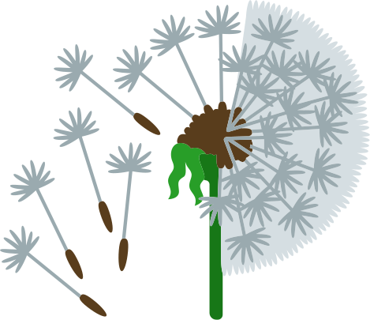

WINTER SOWING BASICS
Seed Basics and Skill Workshop
with Sara Johnson

Slide 2
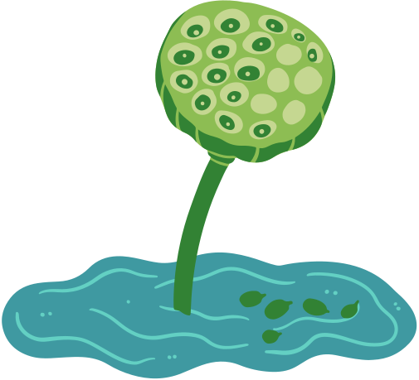
OUR (VERY) LOOSE SCHEDULE FOR TODAY
9:00 - 9:30ish: Intro! to me, to you, to WONA!
9:30 - 10:30ish: Seed Basics and Intro to Seed Collection and Care
10:30 - 10:45ish: Break and Snacks
10:45 - 11:30ish: Seed Sowing and Skills Training (Plant some Seeds!)
11:30 - 12:00ish: Panel and Q & A

Slide 3

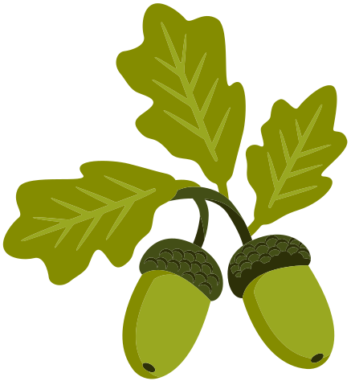
Wild Ones of North Alabama (WONA)
weed wrangles
speakers and seminars
plant and seed swaps
cool workshops like this!
https://northalabama.wildones.org/

Slide 4

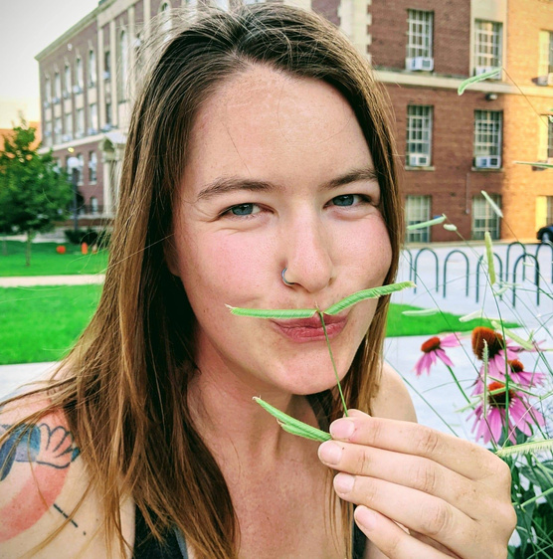
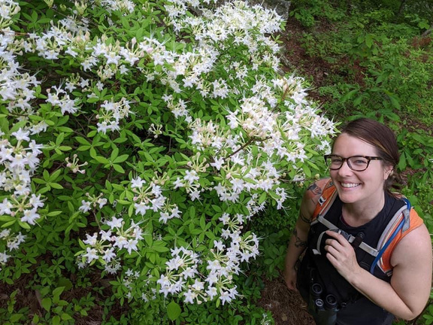
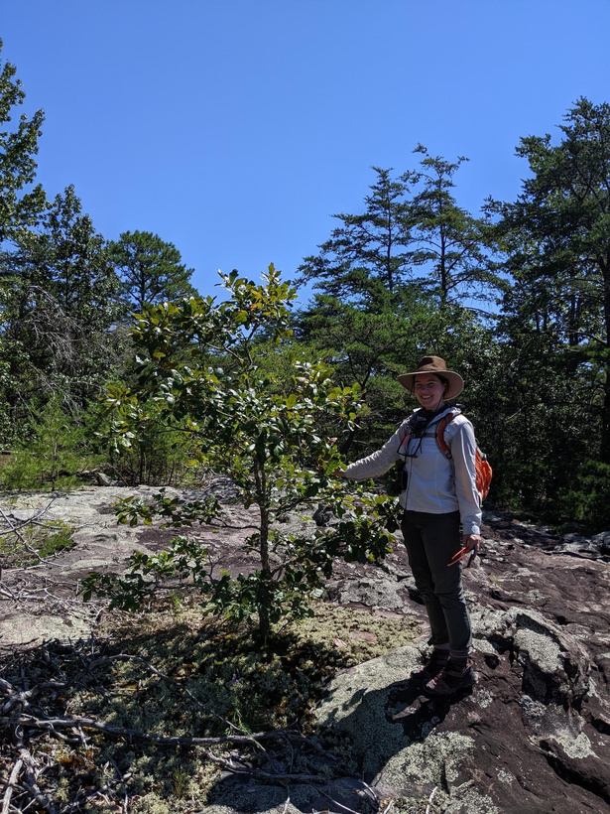
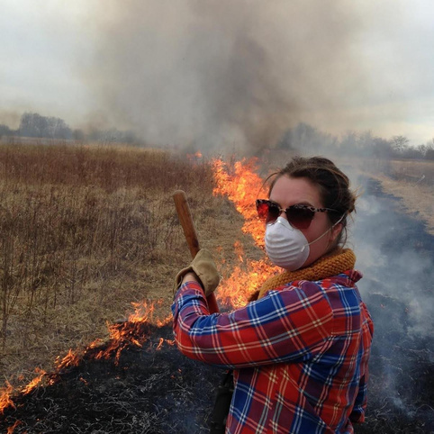
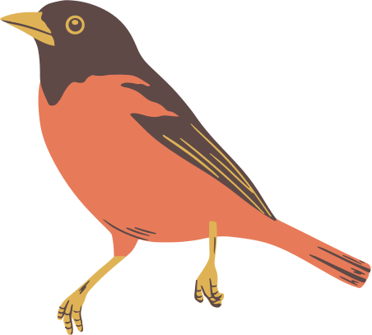
Sara Johnson
Conservation Biologist, North American Land Trust
@sylvatica_sara
Board Member - Huntsville Environmental Coalition
Flint River Conservation Association
www.saraannjohnson.com

Slide 5

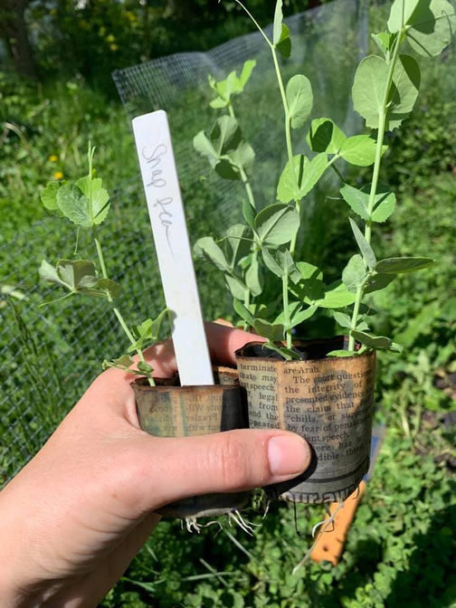
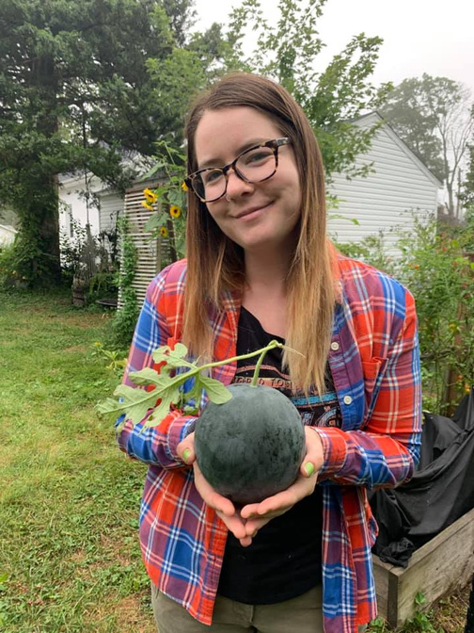
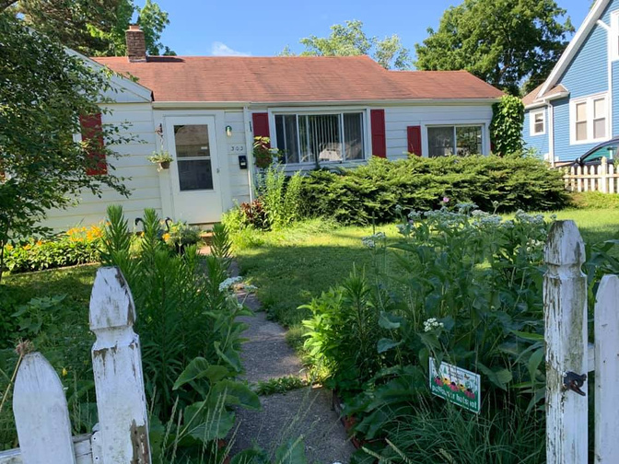
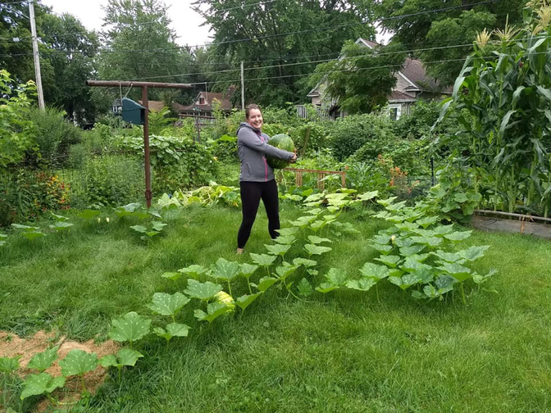
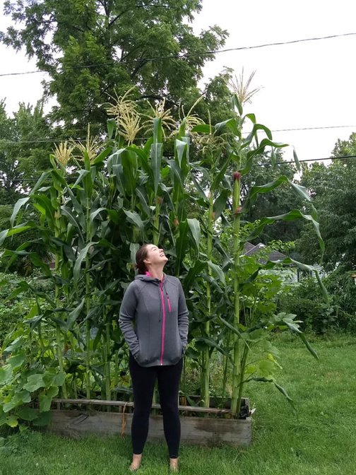
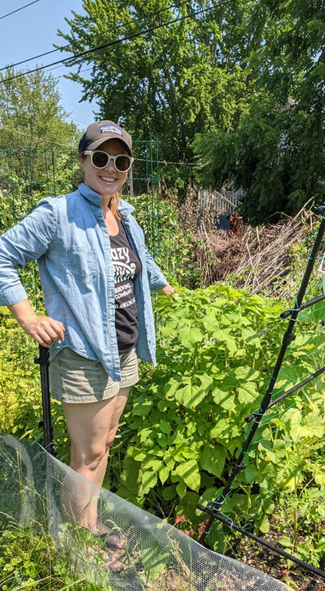
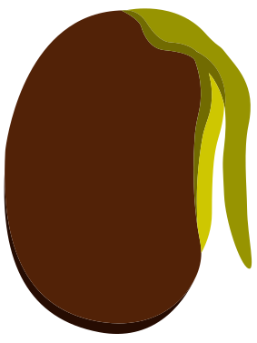
seed OBSESSED
Growing seeds is:
exciting
affordable
diverse
fun!

Slide 6
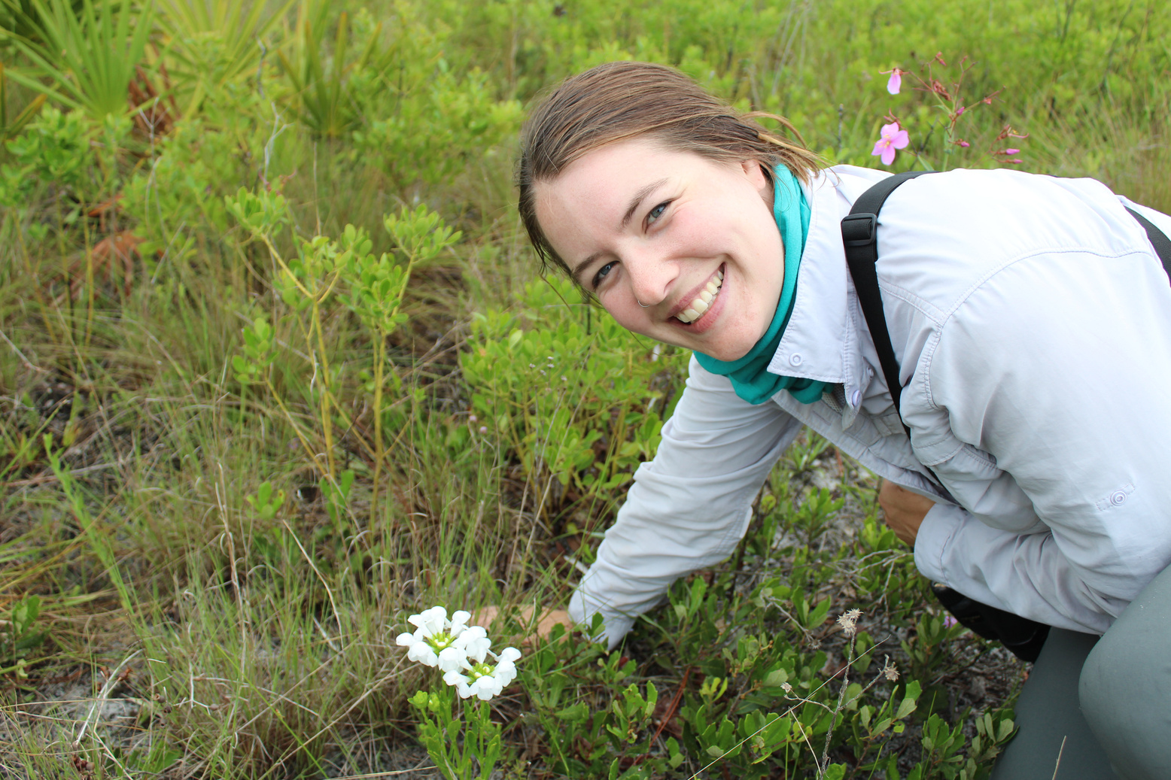
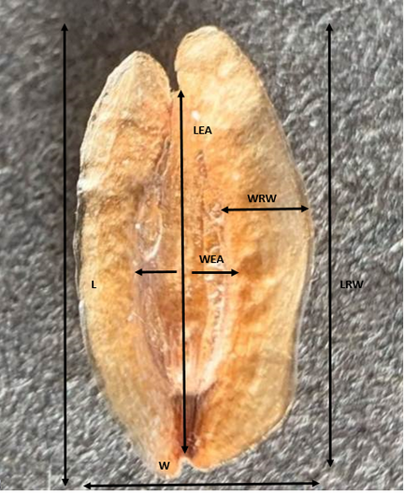
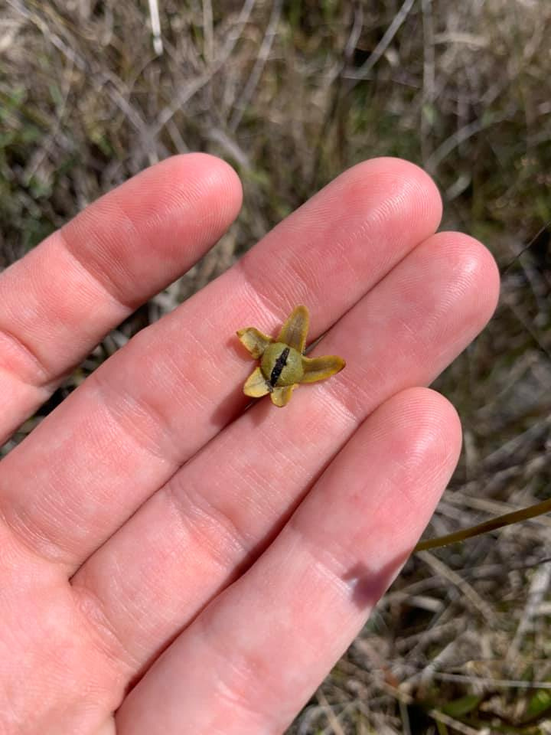
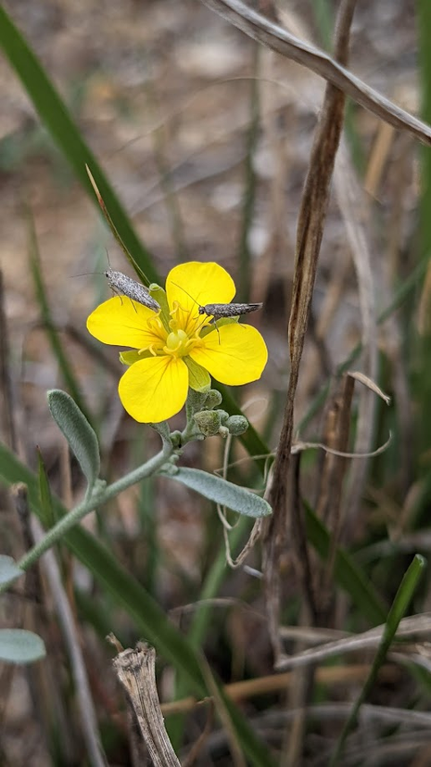
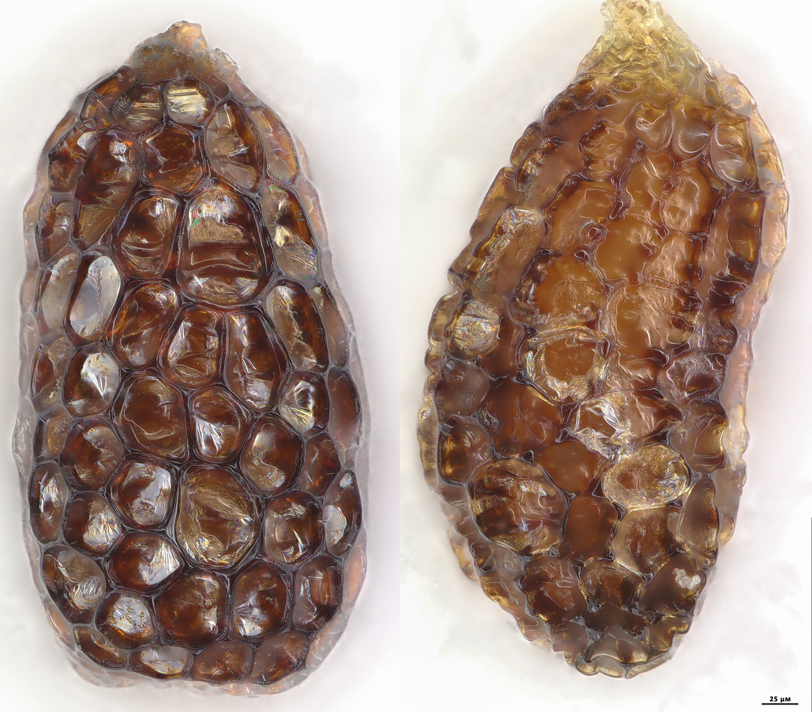
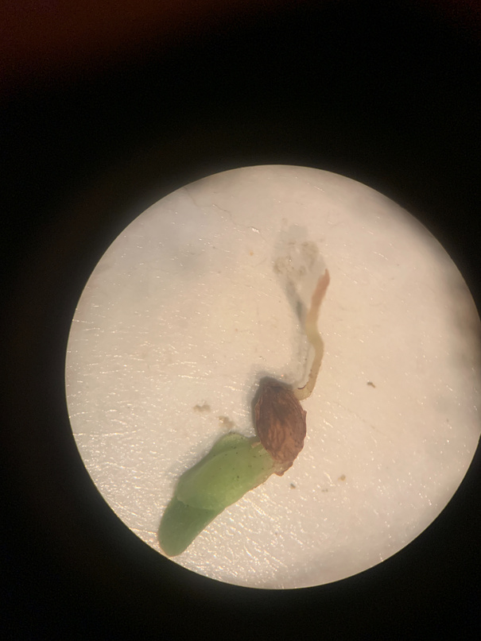
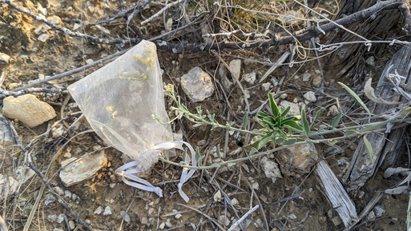
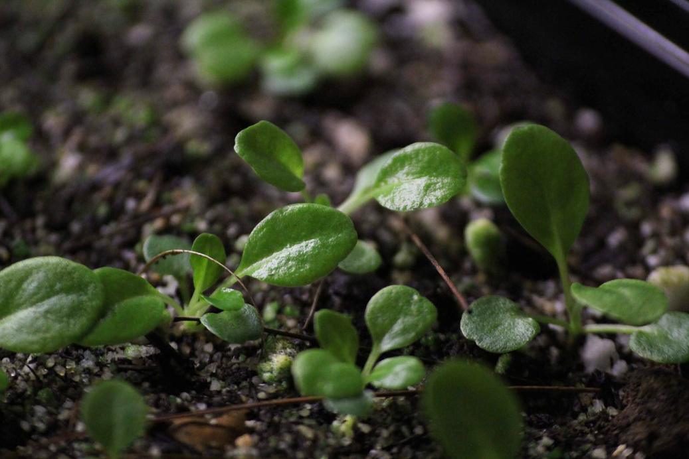
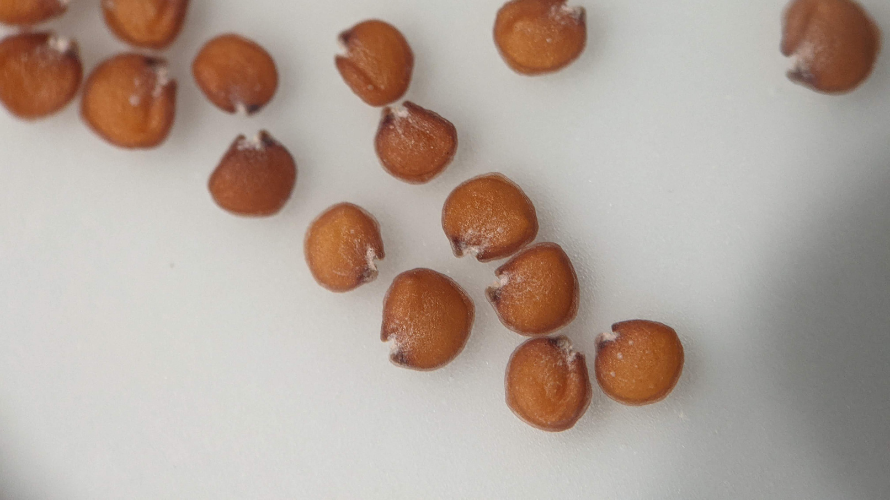
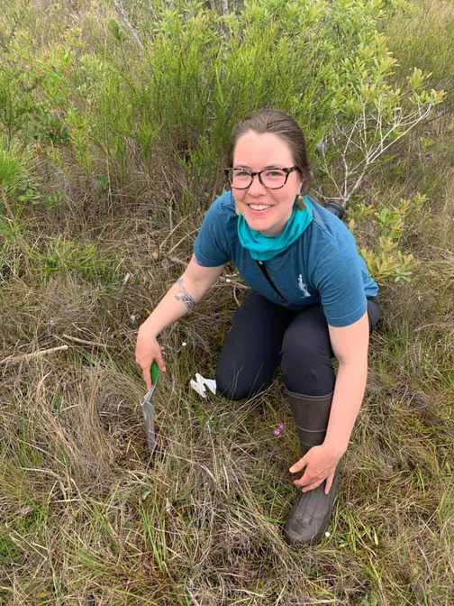


Seeds can inform conservation
morphology
breeding system
genetics
viability
to nerd out on some scientific research:

Slide 7
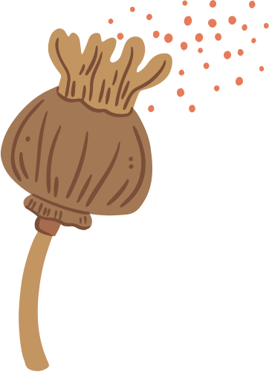
Seeds offer Ecological Cues
Seed traits and what they can tell you
FRUIT TYPE
SIZE
SEED COAT
DISPERSAL STRATEGY
Energy Reserves
Planting Depth
Dispersal Method
Vulnerability (predators, elements etc)
Various types:
Capsule
Achene
Berry
Drupe
Thickness and structure can ID:
dormancy
stratification
Shape and appendages:
wind
water
animals
Notes:
Seed traits can tell us alot about their ecology and what it takes to grow them.
Seed Traits and what they can tell us include:
- Many plants either create many small seeds, or few large seeds, due to energy allocation and limitations to investment in reproduction. Trade-off in strategy for survival vs. reproduction.
Show & Tell Various seed types:
- Milkweed (Silk for wind dispersal)
- Coneflower (achenes)
- Grass (Caryopsis - single (flower) seeded fruit making fruit and seed a single unit called grain or kernal)
- Fleshy Fruits (dogwood, viburnum, etc) require often double dormancy

Slide 8
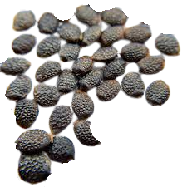
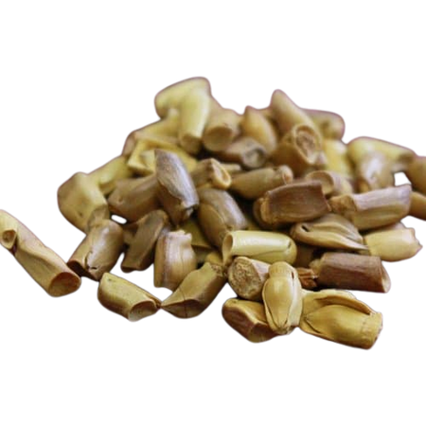
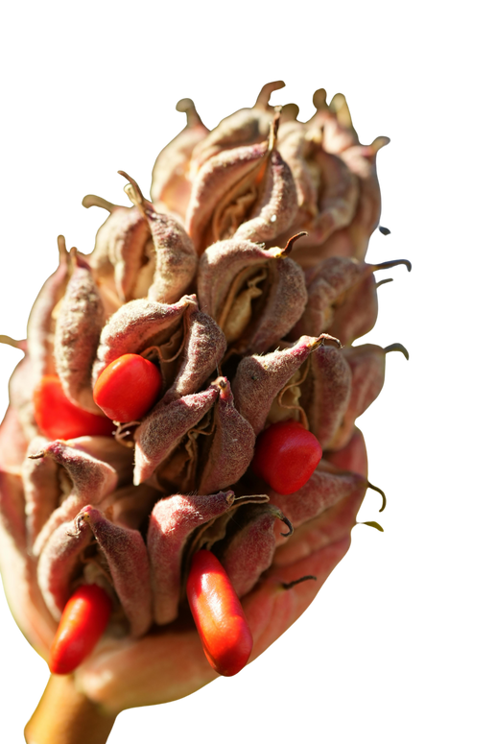
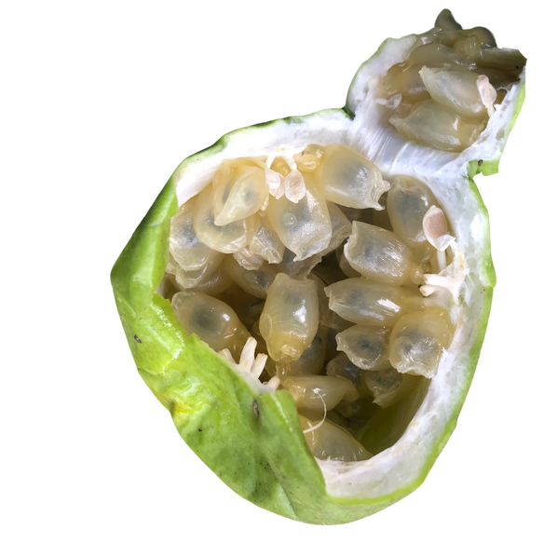
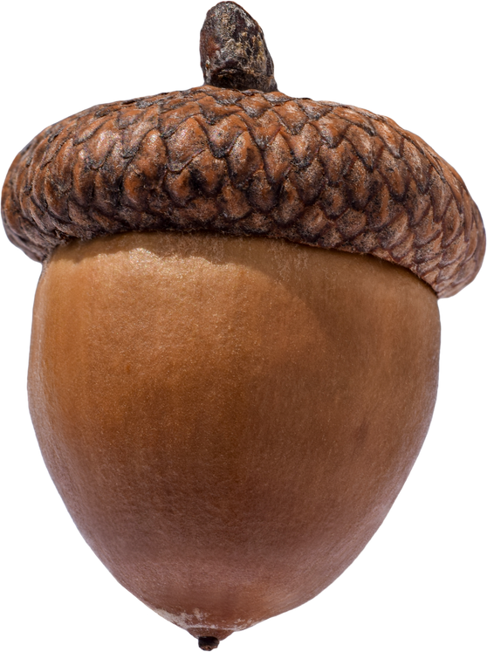
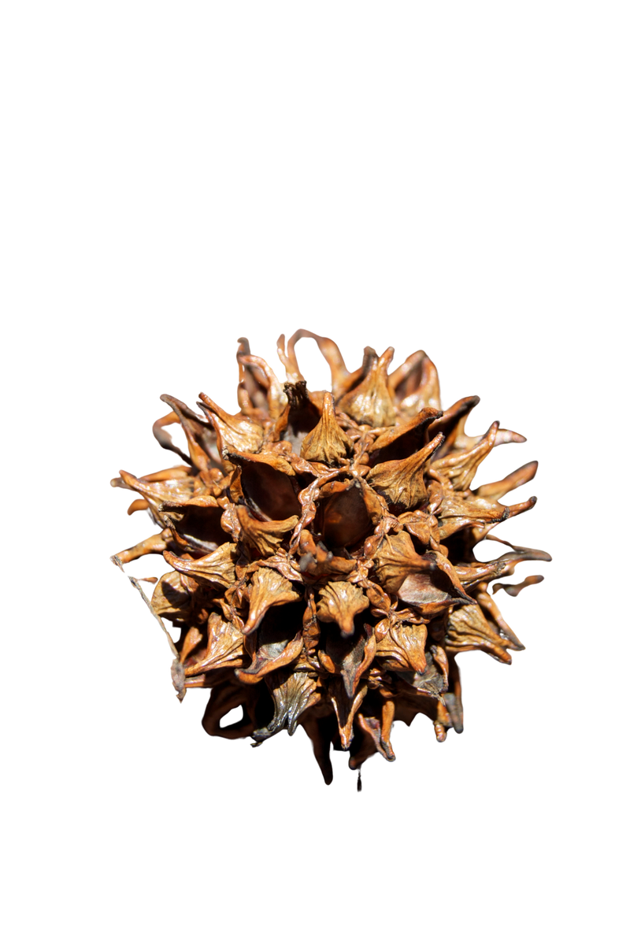
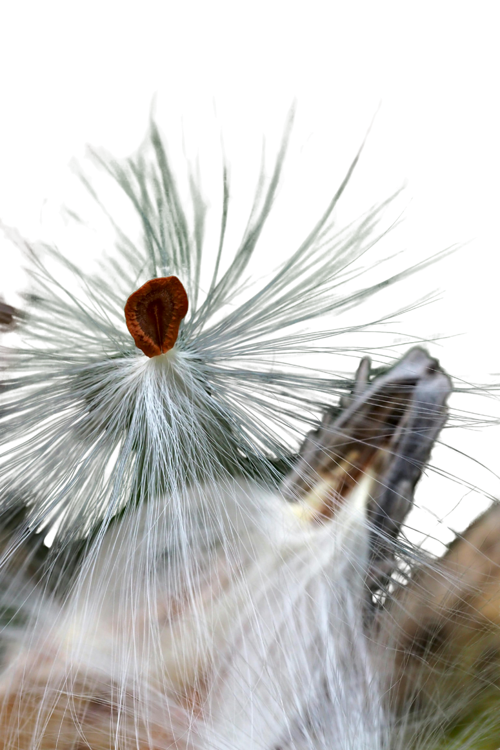
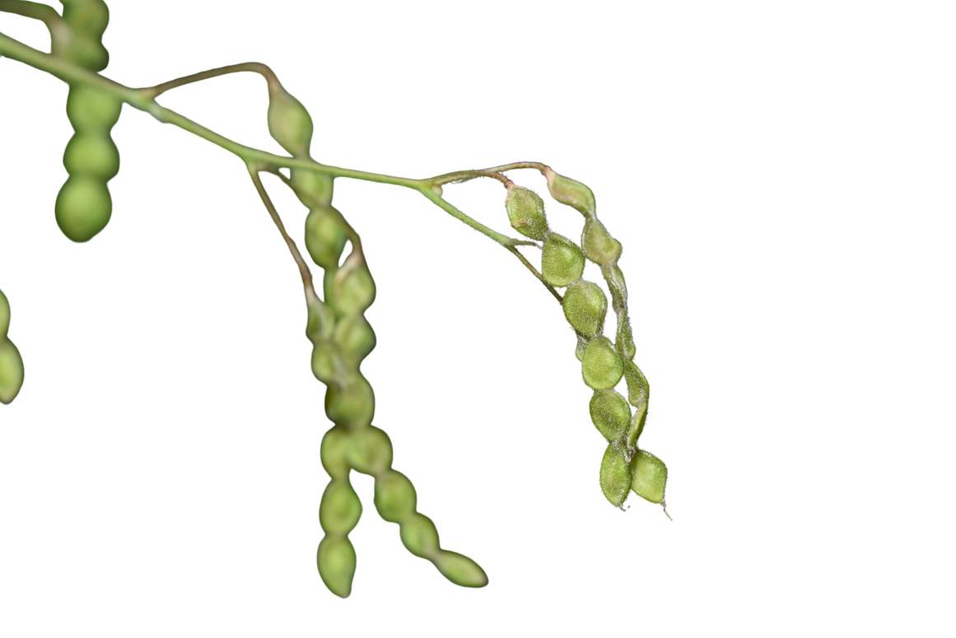
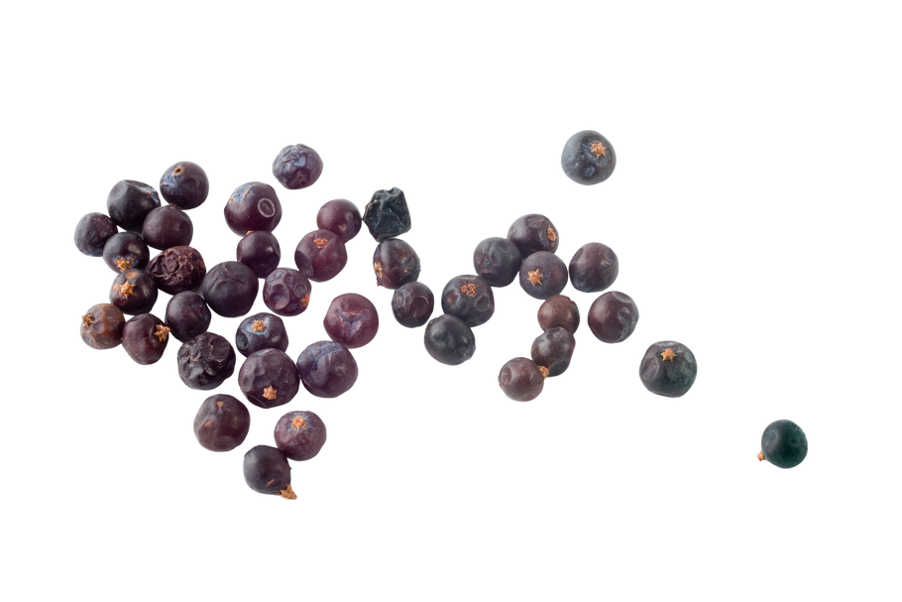
SEED SIZE AND TYPE
Notes:
Seed Shapes are diverse

Slide 9

Seed Coats
Seed coat thickness, shape, and texture can inform germination requirements
TEXTURE
DORMANCY
SCARIFICATION
Parasitism
Seed coats can inform whether a seed will quickly germinate or may take longer / require a double dormancy
Can determine how easily a seed may take up moisture, and sunlight requirements to germinate
Hard or tough seed coats may need physical or chemical prompting to germinate
Notes:
Seed color can correlate with how the outer coating serves various functions, such as camouflage, assisting with dispersal, or protecting the seed from UV light.
Rough/Ribbed: may help adhere to surfaces
Grooved or pitted: may help with water dispersal and absorption
Hairy / Fuzzy / Papery: may help with wind dispersal
Hard or Woody: Provides protection against predators and the environment. May require special treatment to germinate
Spiky/Prickly/Fuzzy/ Sticky: adhere to surfaces to aid in dispersal or to help drive the seed into the soil
Scarification Methods
Mechanical (sandpaper, nicking)
Thermal (hot water) chemical, need to pass thru gut of an animal

Slide 10

Notes:
Seed color can correlate with how the outer coating serves various functions, such as camouflage, assisting with dispersal, or protecting the seed from UV light.
Rough/Ribbed: may help adhere to surfaces
Grooved or pitted: may help with water dispersal and absorption
Hairy / Fuzzy / Papery: may help with wind dispersal
Hard or Woody: Provides protection against predators and the environment. May require special treatment to germinate
Spiky/Prickly/Fuzzy/ Sticky: adhere to surfaces to aid in dispersal or to help drive the seed into the soil

Slide 11
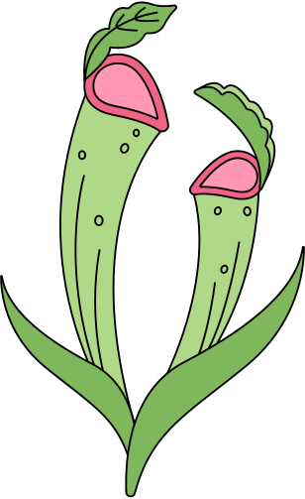
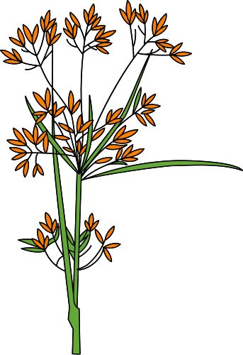
SEED COLLECTION ETHICS
No matter how badly we may want to help our native plant community, it is important to:
1
2
3
ALWAYS collect with permission, whether it be public or private property
Follow the 10% rule, particularly for sensitive/rare species
Never collect from:
Small or stressed populations
protected lands without permits
When possible, partner with organizations to grow and give back, contribute to ex-situ conservation or reintroduction efforts
Notes:
Also, as a general rule if you do not know what something is, you shouldn't collect it. Also, take as much information about seed you collect as possible, location, date, etc. so that if you share, you can let others know where it came from.
This is because you don't know its sensitivity, its needs, how to care for it, and how to store / grow it successfully, which could essentially be wasteful.

Slide 12
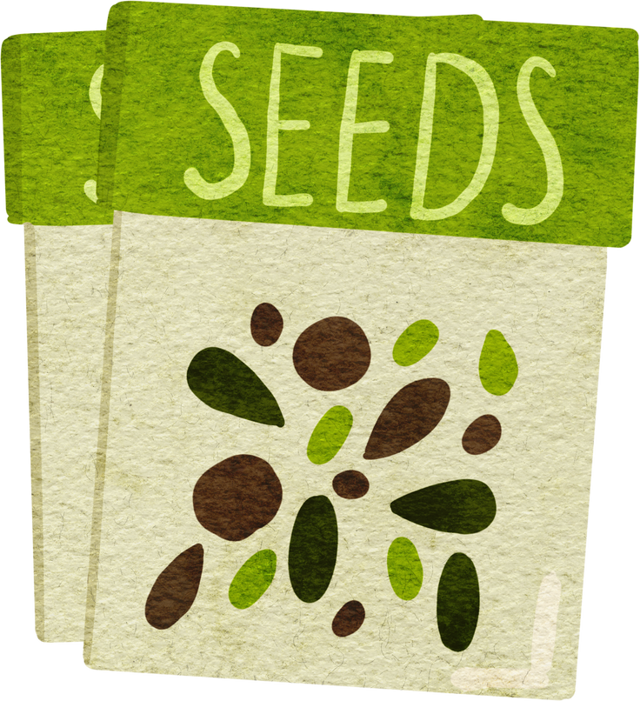
Seed Collection Basics
What to look for when
sourcing seed
Eco-regionally appropriate
Species, not cultivars
Collection info when available
Red Flags
No species names
Treated or coated seed
“Wildflower mix” ambiguity
How to know when seed is ready to harvest
Visual Cues like color change, dehiscence, maturity
Dry vs. fleshy fruits
Lack of any signs of damage or disease (i.e. insect / fungi)
Notes:
If you can't tell, dont collect it. Some seeds do not mature post harvest. Some do.

Slide 13


WHERE TO SOURCE
When possible, it is always best to source locally
Seed swaps / exchanges from reputable sources
Offer to help with local gardens and conservation orgs
Purchase plants / seeds from respected sellers
collect from your own homegrown natives and share with others
scan this for a list of regional
native plant nurseries

Slide 14
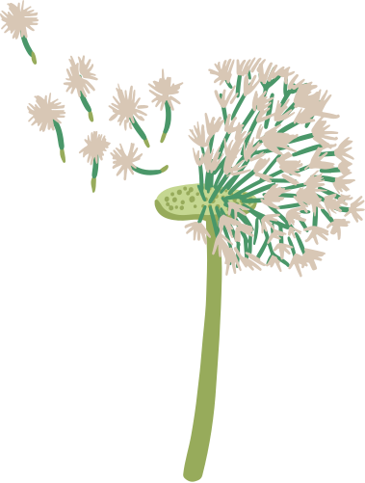
SEED PREPARATION
Seed types and seed cleaning and preparation methods
CONVENTIONAL SEED
UNCONVENTIONAL SEED
can be stored using traditional methods and may require little preparation before storage
Examples: dry seed, capsules, grasses etc.
can be difficult to store using traditional methods, may need cryo or special humidity and temperature requirements to last
Examples: berries, hips, drupes, orchids, carnivorous plants, etc

Slide 15
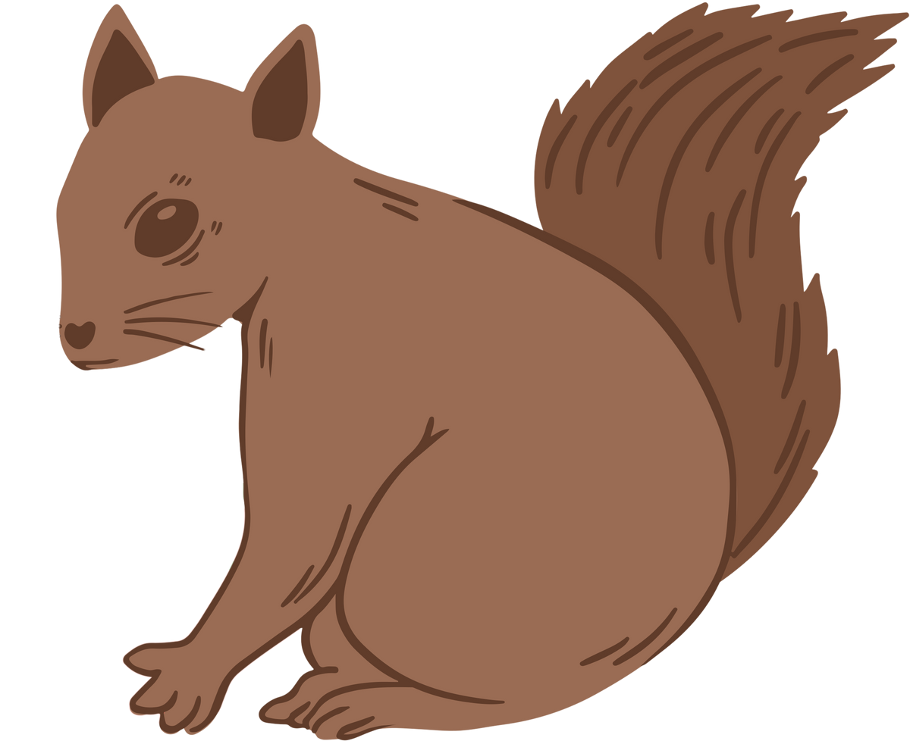

SEED STORAGE
The Storage Triangle
Temperature: cool is better
Humidity: dry (but not desiccated for all species)
Time: viability varies by species
Common Problems
Mold/fungal growth
Loss of viability
Storage Tips
Paper envelopes for dry seed
Airtight containers with desiccant
Refrigeration when appropriate
Notes:
cool is better, but most can not tolerate freezing.
most must be dry before storage, especially cold storage, but some will not be viable if they fully dry out (think about acorns, etc)
small seeds in general will last a shorter time in storage than large seeds.

Slide 16
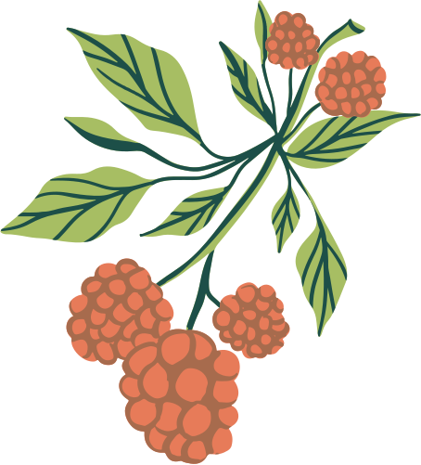
DORMANCY & STRATIFICATION
Types of Dormancy
Physical dormancy (hard seed coats)
Physiological dormancy
Double dormancy (warm + cold cycles)
Stratification Methods
Natural (winter sowing!)
Cold moist stratification (refrigerator)
Key message: Let nature do the work when possible.
Notes:
Native seed can be sown outdoors during the winter months and even into very early spring.
The combination of cold weather, ice, and snow provides natural stratification conditions needed for germination, which occurs during warmer spring weather. Stratification refers to chilling seeds that have absorbed some water.
Seed often requires a period of one to four months of dormancy, when the seed is alive but inactive. Protective seed mechanisms, such as thick seed coats or germination-inhibiting chemicals, ensure that young plants do not sprout during fall rains and freeze in winter. Cold weather and repeated exposure to moisture soften seed coats and dissolve inhibiting chemicals when conditions are optimal.

Slide 17
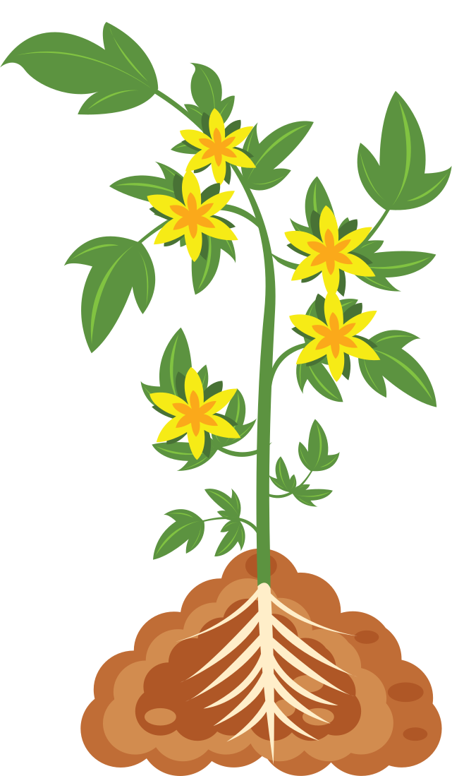
BREAK
TIME

Slide 18
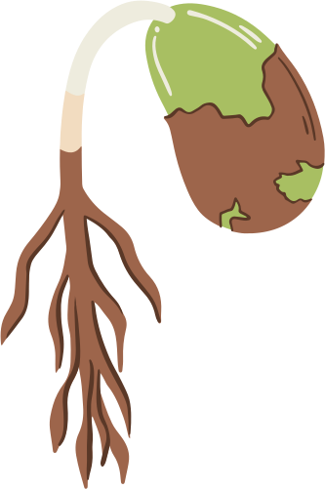
Intro to Winter Sowing
Winter sowing is an easy, low cost way to start seeds during the dormant season.
A) Uses cold to break dormancy.
B) Mimics natural conditions.
C) Allows seed to germinate at just the right time.

Slide 19

Why winter sowing rules
Winter sowing lets nature do the work for you
Set it and Forget It
Perfect for Native Plants (but also lots of edible/ ornamentals too)
Hardens off your plants for you!
Does not require lights/heat etc
Offers HOPE in the depths of winter!

Slide 20

Sowing Methods (Pros & Cons)
MILK JUGS
TRAY METHOD
POTS
DIRECT SOWING
Materials
Cutting & Drainage
Filling, Sowing, Labeling
Watering & Placement
Materials
Pros/Cons
Watering & Placement
Protection from elements
Materials
Individual species / mixed
Pros / Cons
Reading Conditions (soil and climate)
Temperature Cues
Planting Depth
Pros / Cons
Notes:
Direct: Mix seed with vermiculite, sand, or sawdust so the light color makes the planting area more visible and the added bulk helps with even spreading. Sow the seed mixture evenly by hand in two directions for good soil contact. Since the ground will likely be frozen or wet, it may not be possible to rake seeds into the soil.
Birds may relocate seeds to new, unplanned areas, which may add to your enjoyment, but some experts recommend covering the planted site with hardware cloth to deter wildlife.

Slide 21
Getting Wild Seeds Off to a Good Start
To cold stratify indoors / refrigerator and then move to the outdoors
Store seeds in a dry, cool place in paper bags or jars.
Activating seeds for planting requires stratification. This simple process is done eight weeks before planting. Mix a teaspoon of seed and a teaspoon of moist sand.
Rub sand and seed together for a minute to expose the seeds to moisture. Seal the bag, label it, date it, and refrigerate it.
Eight weeks later, clean a flat with a 10 percent bleach and 90 percent water solution and fill it with moistened, sterile potting soil.
Spread the refrigerated seed and sand mixture on the surface of the soil. Cover with vermiculite and mist with water.
Label the tray with the plant name and date. Cover with a sheet of paper, not plastic, and place where warmth will enter from the bottom. Place a light over the tray.
The top surface of the refrigerator is an ideal out-of-the-way place for the tray, with room for a lamp.
In a couple of weeks, seedlings will sprout. Replant them into six-pack trays, with one plant to each section.
Allow growth until they have developed three or four leaves, then move them to larger containers.

Slide 22
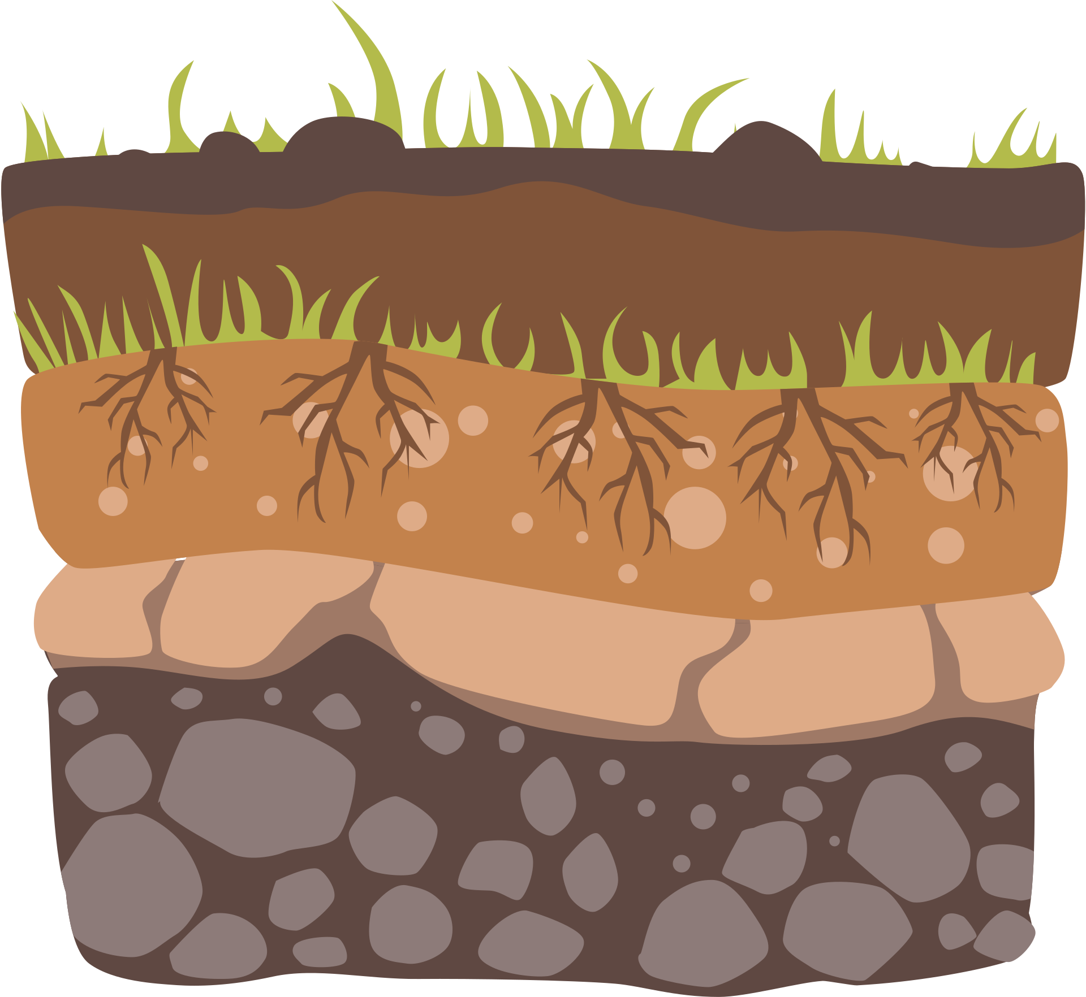
SOIL
What to Avoid
Heavy garden soil
High compost content
Ideal Winter Sowing Mix
Free-draining
Low fertility
Examples:
Seed-starting / Potting mix
DIY blends (coir + perlite + sand)

Slide 23
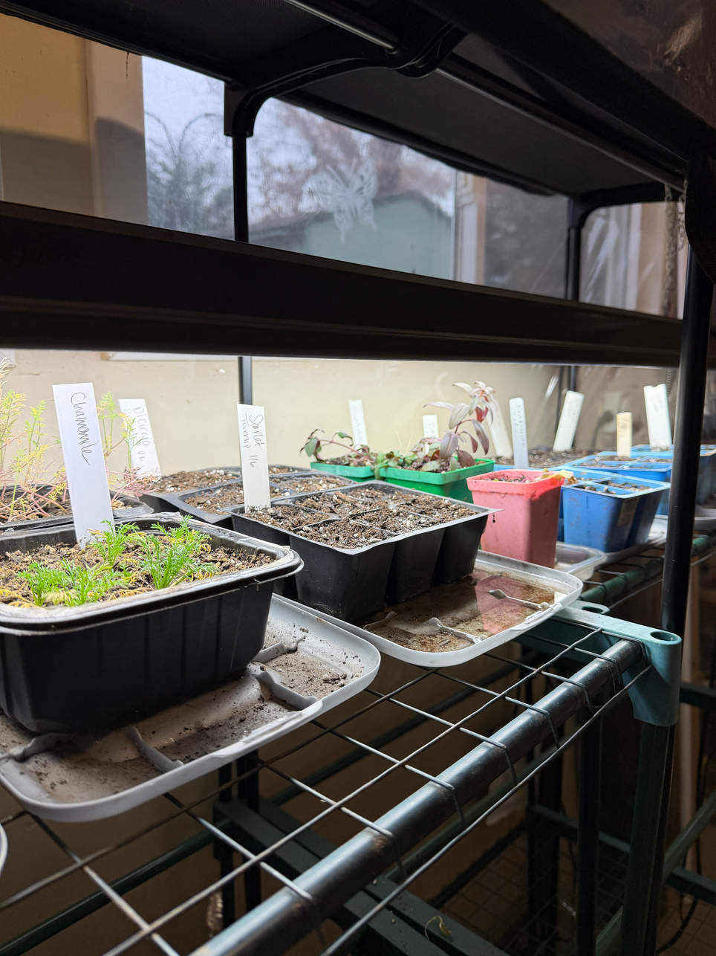
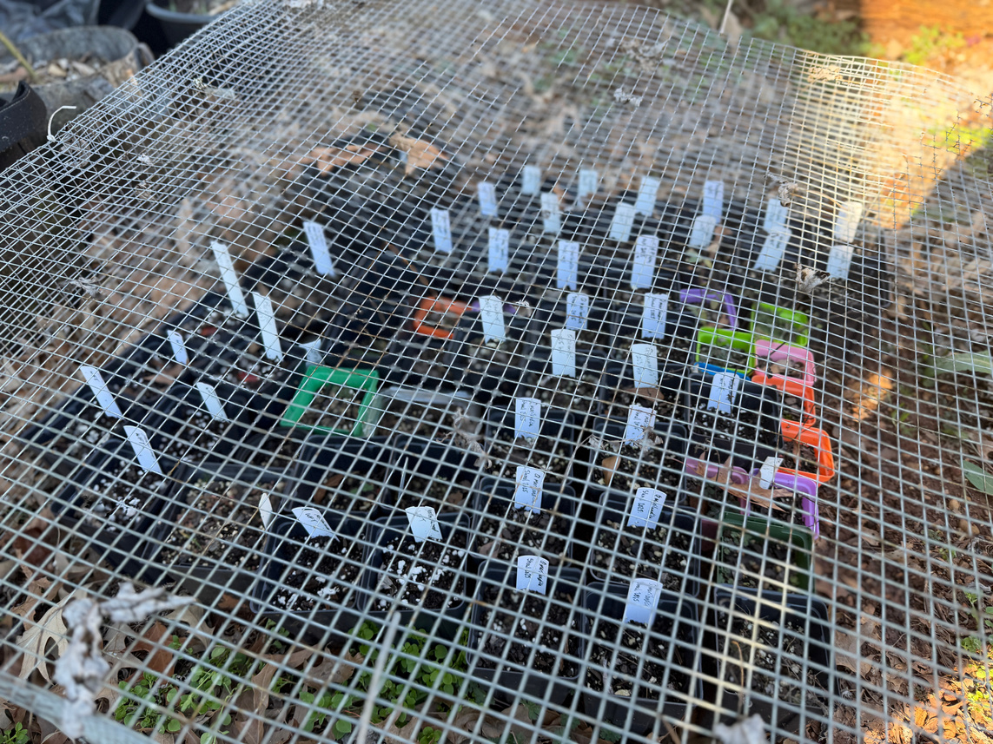
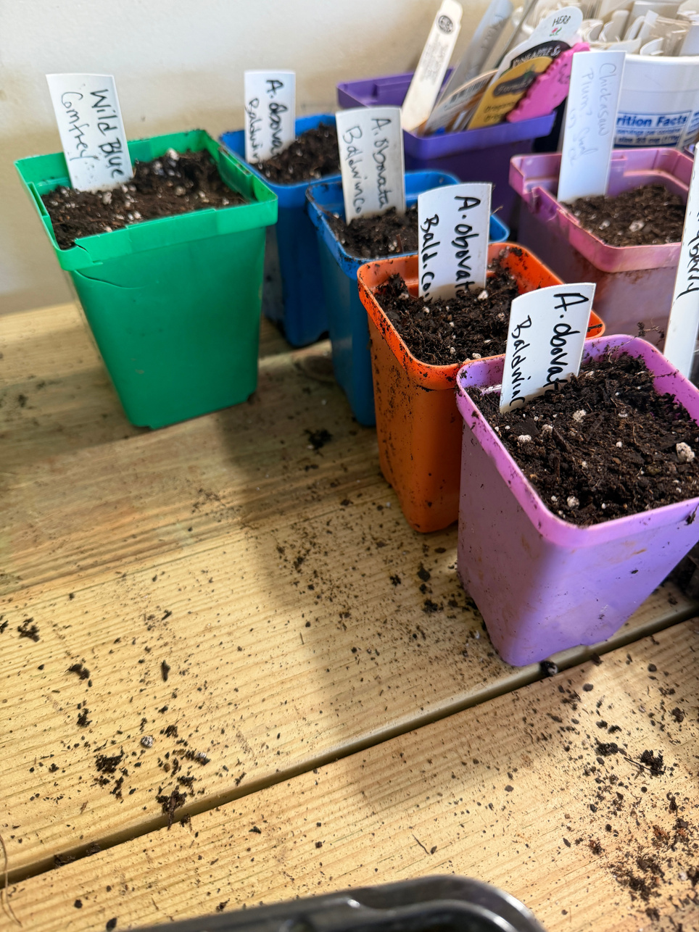
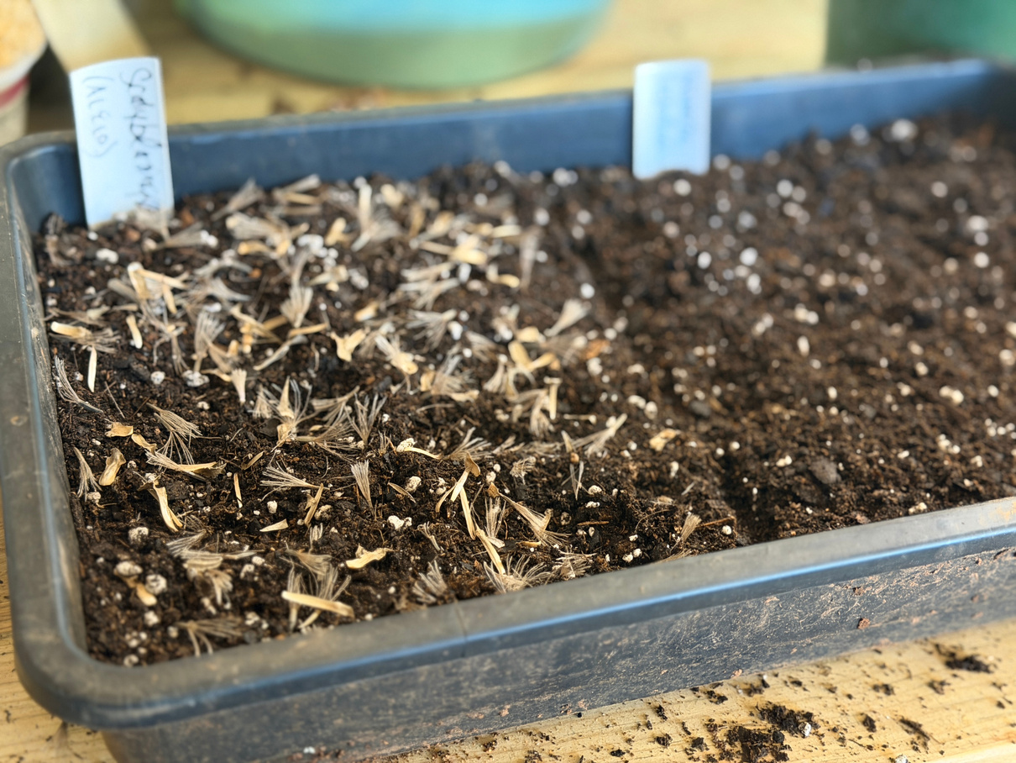
Helpful
Tips & More
Tools
Dibble or pencil
Permanent labels
Marker types
Protection
Fencing
Chicken wire or hardware cloth
Elevation from ground

Slide 24
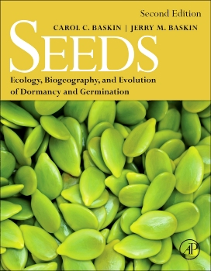
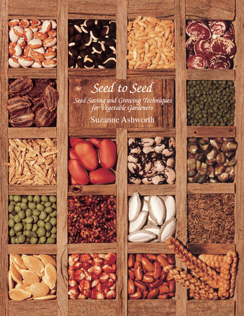


Thank you!
Additional Resources
Learning from Seeds: Winter Sowing, Seed Starting, and Youth Discovery - Wild Ones: Native Plants, Natural Landscapes

